Slide 1

Advertising Ethics, Laws, and Regulations
Travis Bohling, Jason Budniewski, Joshua Carpenter, Ifetayo Green, Rachel Novak, & Shannon Ritchie
Advertising and the Media/BSCOM300
March 20, 2017
Ricardo McCoy

Slide 2
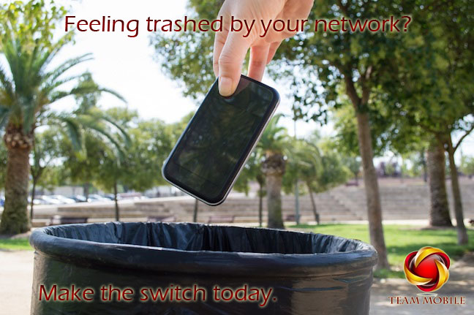

Slide 3
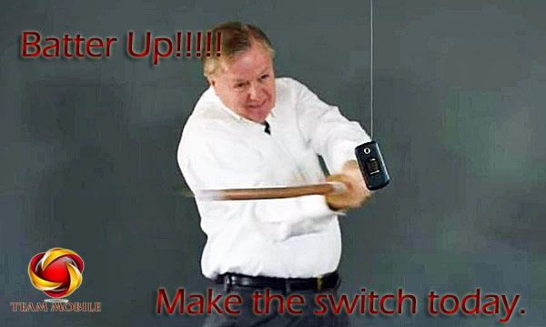

Slide 4


Slide 5


